Slide 1
Module 2:
Data Types, Files and Databases
In
MS SQL 2008
Author:
Kaushik Natua

Slide 2
Objectives
After completing this session, you will be able to:
Data types of SQL Server 2008
Types of Files present in SQL Server 2008
Databases in MS SQL 2008

Slide 3
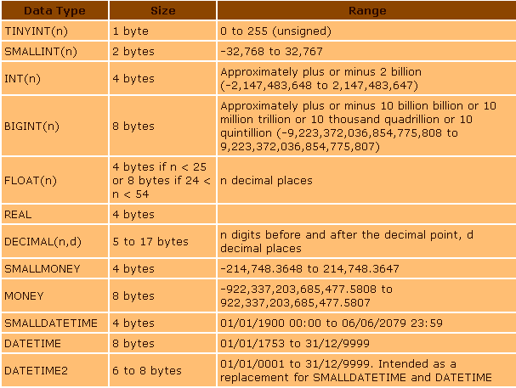
Data types in MS SQL 2008

Slide 4
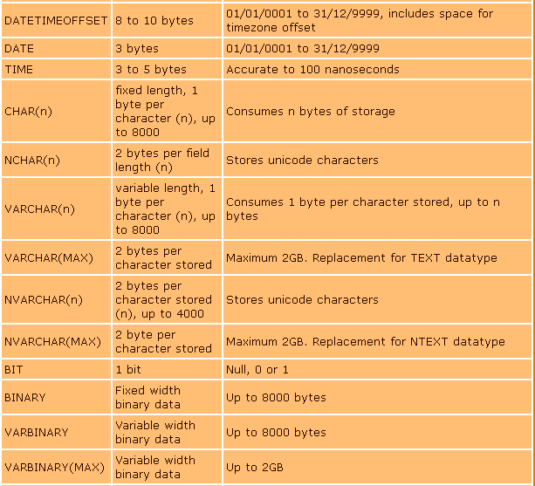
Data types in MS SQL 2008 (Contd.)

Slide 5
Files and Filegroups
SQL Server maps a database over a set of OS files.
Data and log information are never mixed in the same file, and individual files are used only by one database.
Filegroups are named collections of files and are used to help with data placement and administrative tasks such as backup and restore operations.
SQL Server has three types of files:
Primary File
Secondary File
Transaction Log File

Slide 6
Files and Filegroups
Primary data files: The primary data file is the starting point of the database and points to the other files in the database.
Every database has one primary data file.
The recommended file name extension for primary data files is .mdf.

Slide 7
Files and Filegroups
Secondary data files: These files make up all the data files, other than the primary data file.
Some databases may not have any secondary data files, while others have several secondary data files.
The recommended file name extension for secondary data files is .ndf.

Slide 8
Files and Filegroups
Log files: These files hold all the log information that is used to recover the database.
There must be at least one log file for each database, although there can be more than one.
The recommended file name extension for log files is .ldf.

Slide 9
Database
A database is a container for objects that not only store data, but also enable data storage and retrieval to operate in a secure and safe manner.
There are three types of databases:
System Database
Sample Database
User defined Database

Slide 10
System Databases
System database always stores information about SQL Server as a whole.
SQL Server applies system database to operate and manage the system.
The following are the System Databases:
master
model
msdb
tempdb

Slide 11
Sample Database
Extensive sample database provided by Microsoft which is handy in experimenting.
These databases have to be downloaded and installed in SQL Server separately.
Two sample databases are very popular in market:
Pubs
Northwind

Slide 12
User defined database
User defined databases are created by developers to do their own work.
If we want to create a new database with the name “kaushik” we write the code:
create database kaushik
If you want to see the entire content of the database, write the code:
sp_helpdb kaushik

Slide 13
Rename and Delete User defined database
Rename a database:
Suppose we want to rename the database “kaushik” to “DigitalDoamin” then we write the following code:
sp_renamedb kaushik, DigitalDomain
Delete a database from the server:
Suppose we want to delete the database “DigitalDomain” from the server. Here we write the code:
drop database DigitalDomain

Slide 14
Thank You…!

